Slide 1
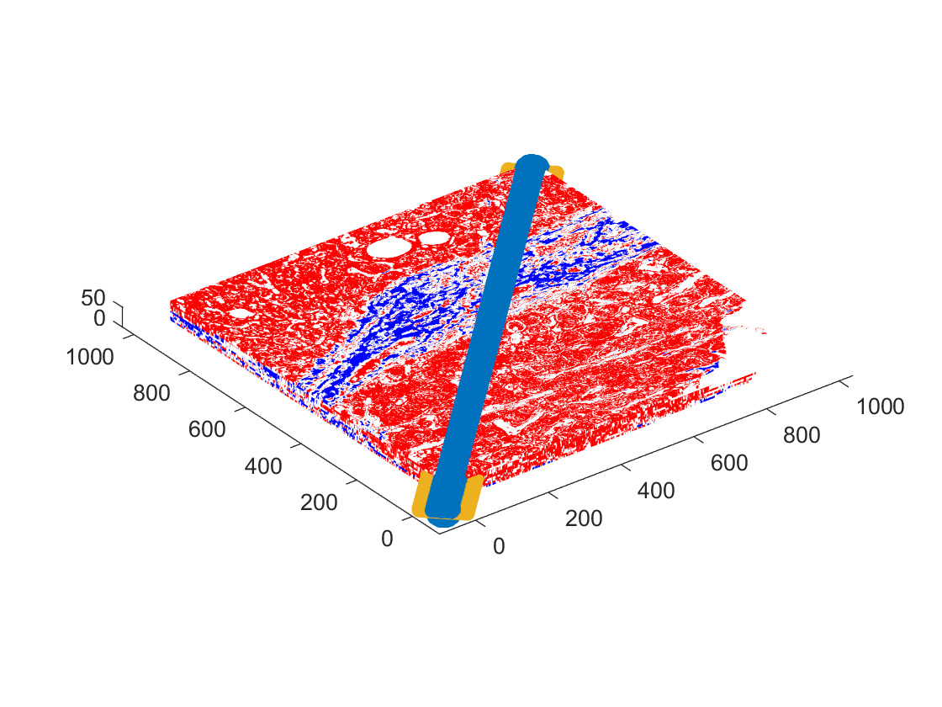
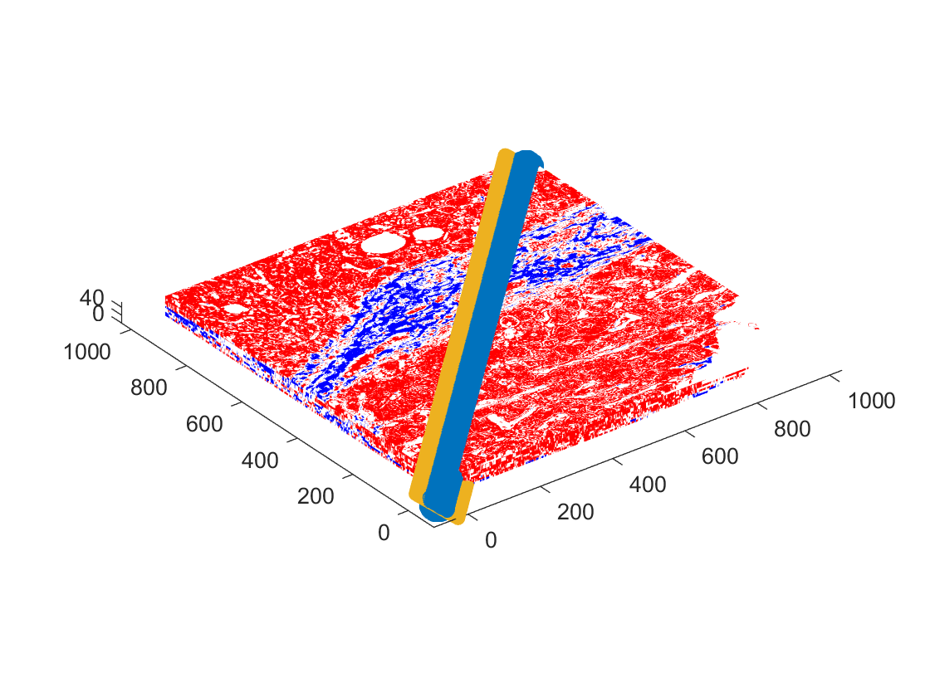
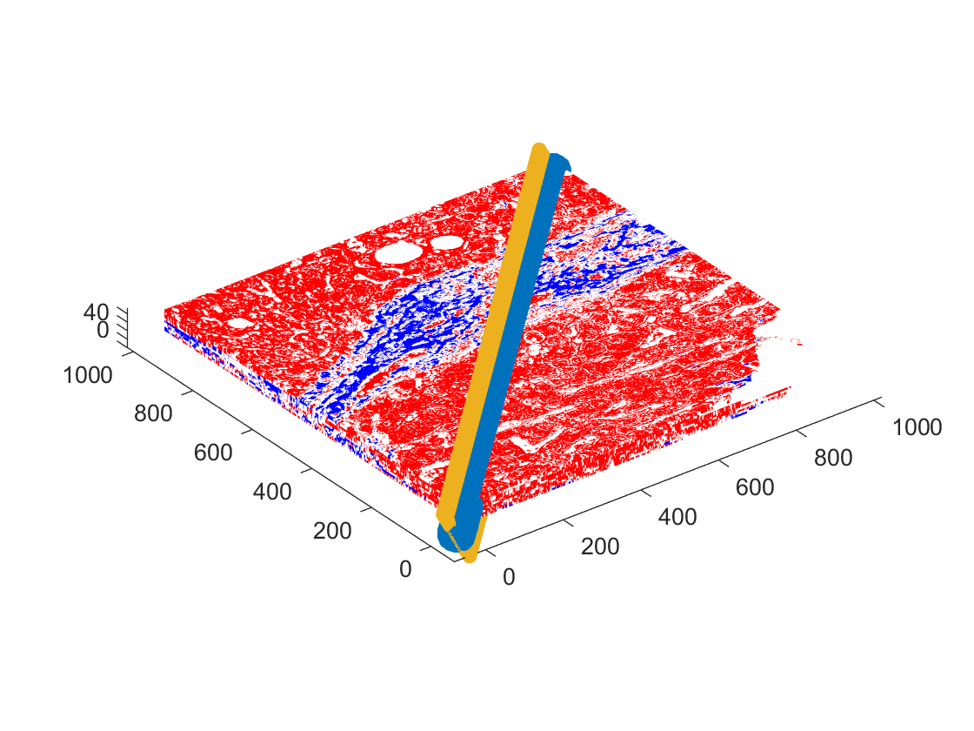

Cross-section
Cross-section
(a) (b)
Cross-section
Cross-section
(c) (d)

Slide 2
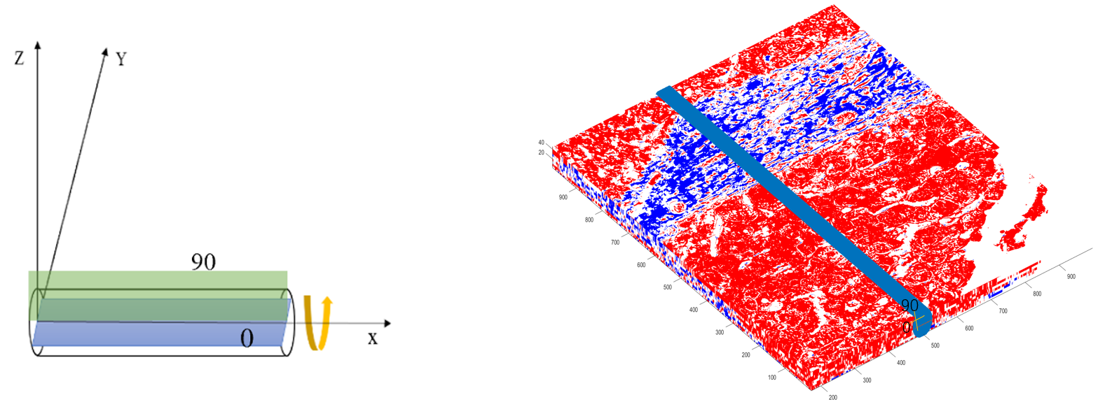
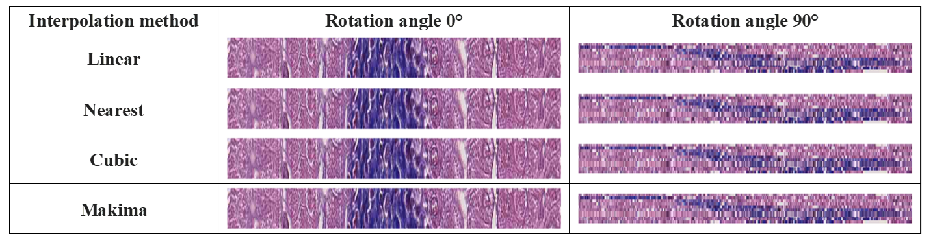
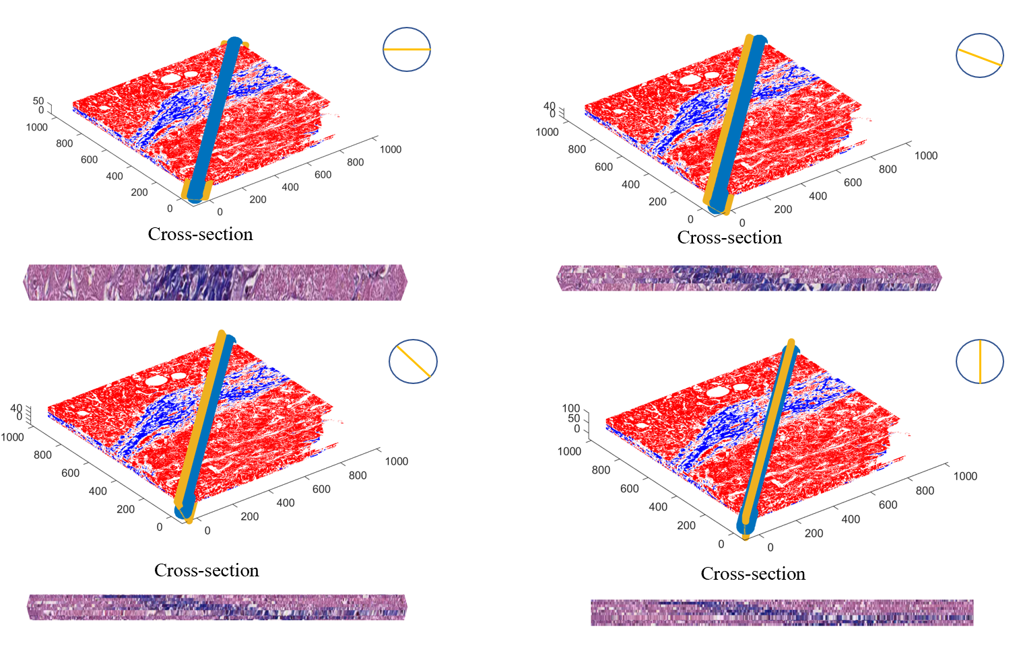
()
(a)
(b)
(c)

Slide 3
Cross-section
Cross-section
Cross-section
Cross-section

